Slide 1





Company Profile
Shenzhen Starlink Technology Co., Ltd.
Danik Hu
sales@qixingtechnology.com

Slide 2




Introduction
Established in 2018& headquartered in Shenzhen,
Shenzhen Starlink Technology Co., Ltd. is a leading Fiber Communication and IP CCTV Security System Transmission product manufacturer in China.
Starlink products are widely applied to network systems of Telecom, Radio and Television, Public Security, Bank , etc.
Brand:

Slide 3


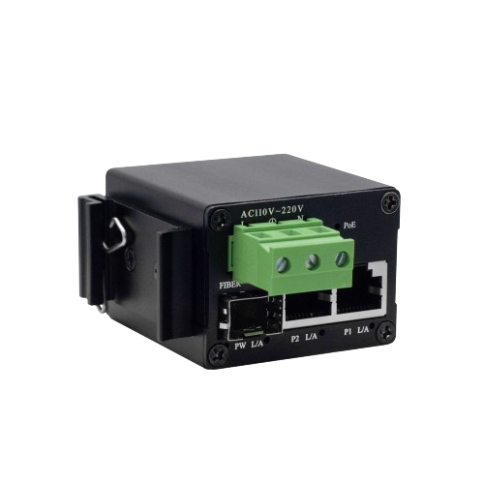
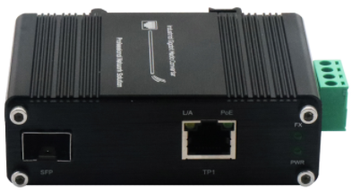
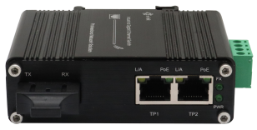
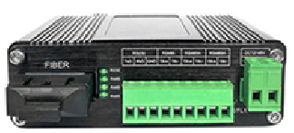

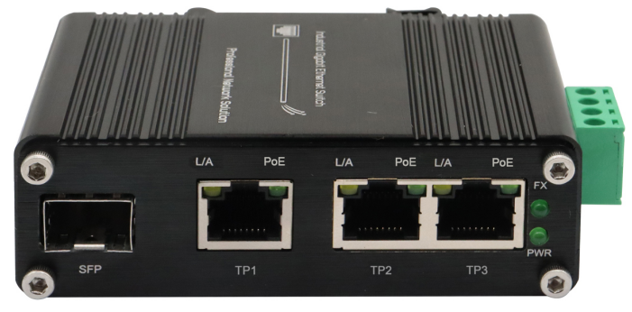
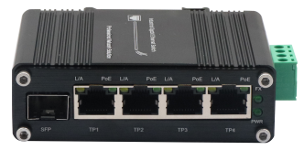
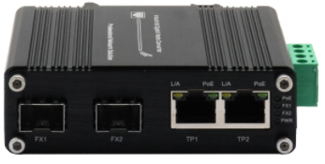
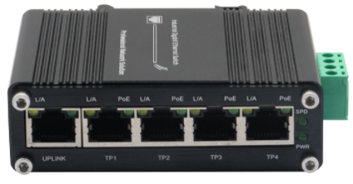
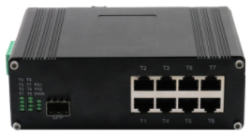
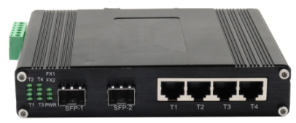
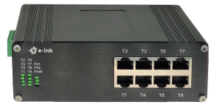
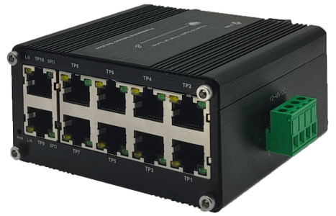
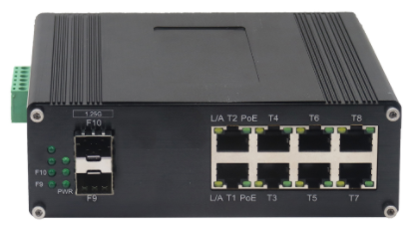
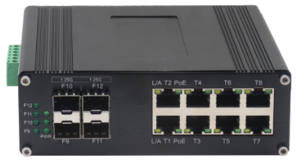


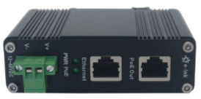
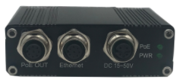
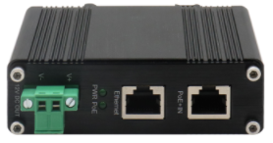
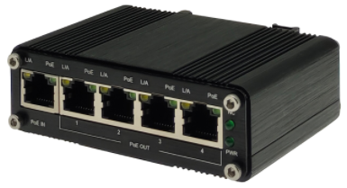
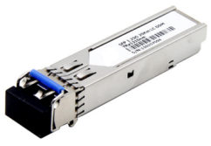
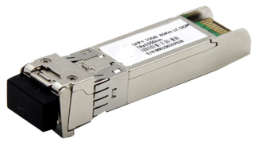
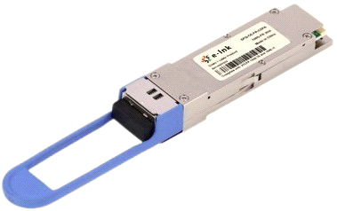
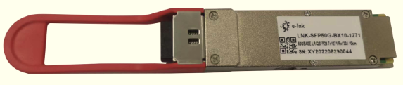
Product Lines
Media Converter
Switching
Power over Ethernet
1/10/50/100G SFP Module
(Commercial/Industrial)

Slide 4

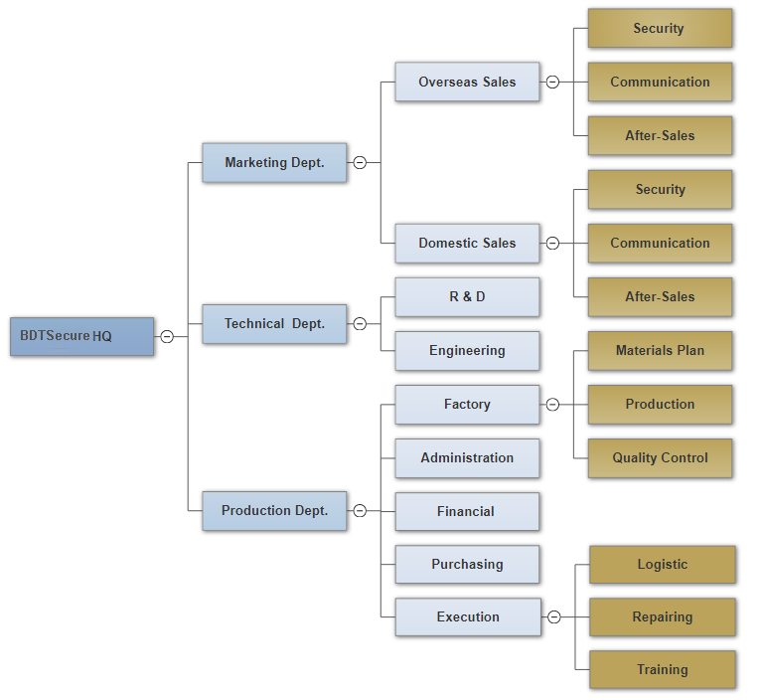
Organizational Chart

Slide 5



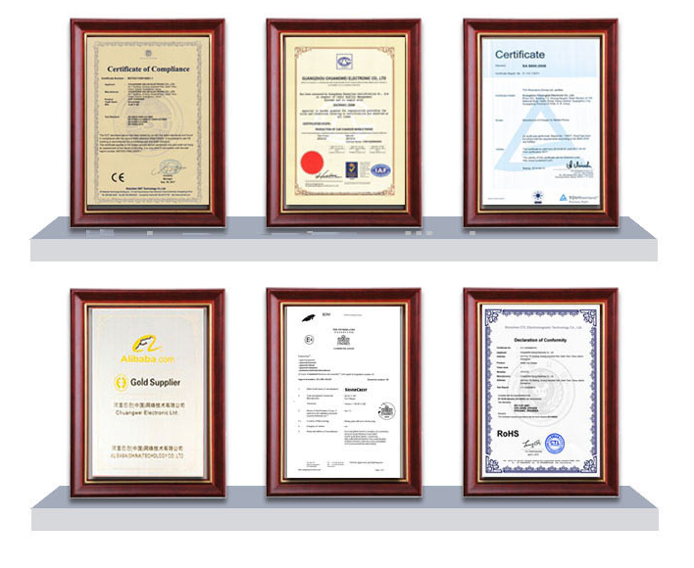
Quality Management
ISO9001:2000 certified
Strict and complete quality controlling system
Test System & Means: Test Machine for Power Supply; 48 hours aging test;
Products comply with RoHS, CE, FCC, SGS, TUV, etc. requirements
Repairing Rate < 0.3%

Slide 6

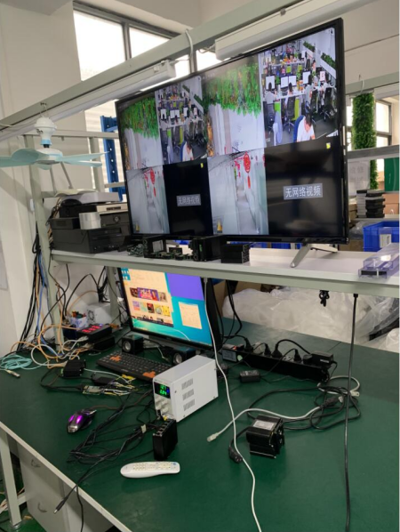
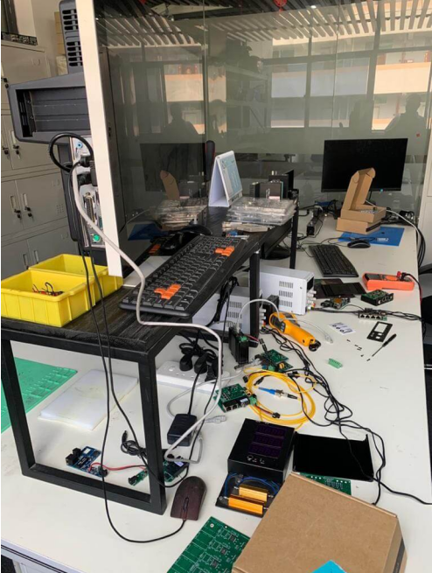
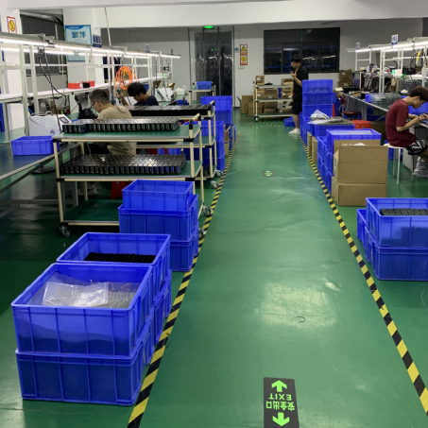
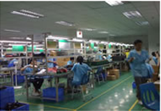
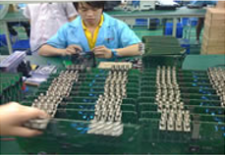
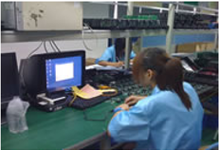


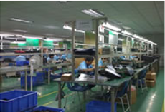
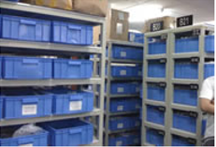
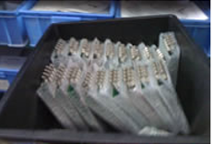
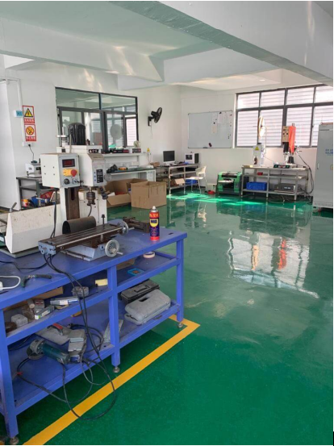
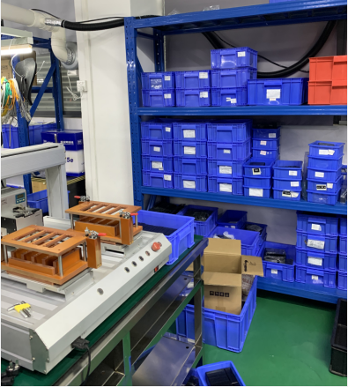
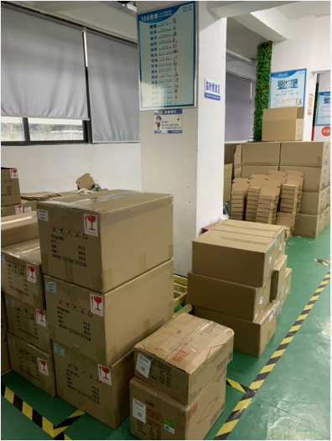

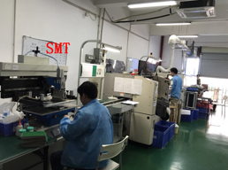
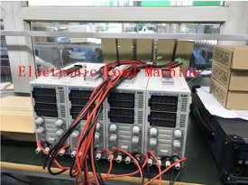
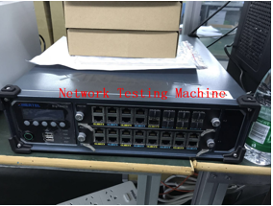

Shenzhen Factory
Located in Shenzhen, Guangdong Province

Slide 7









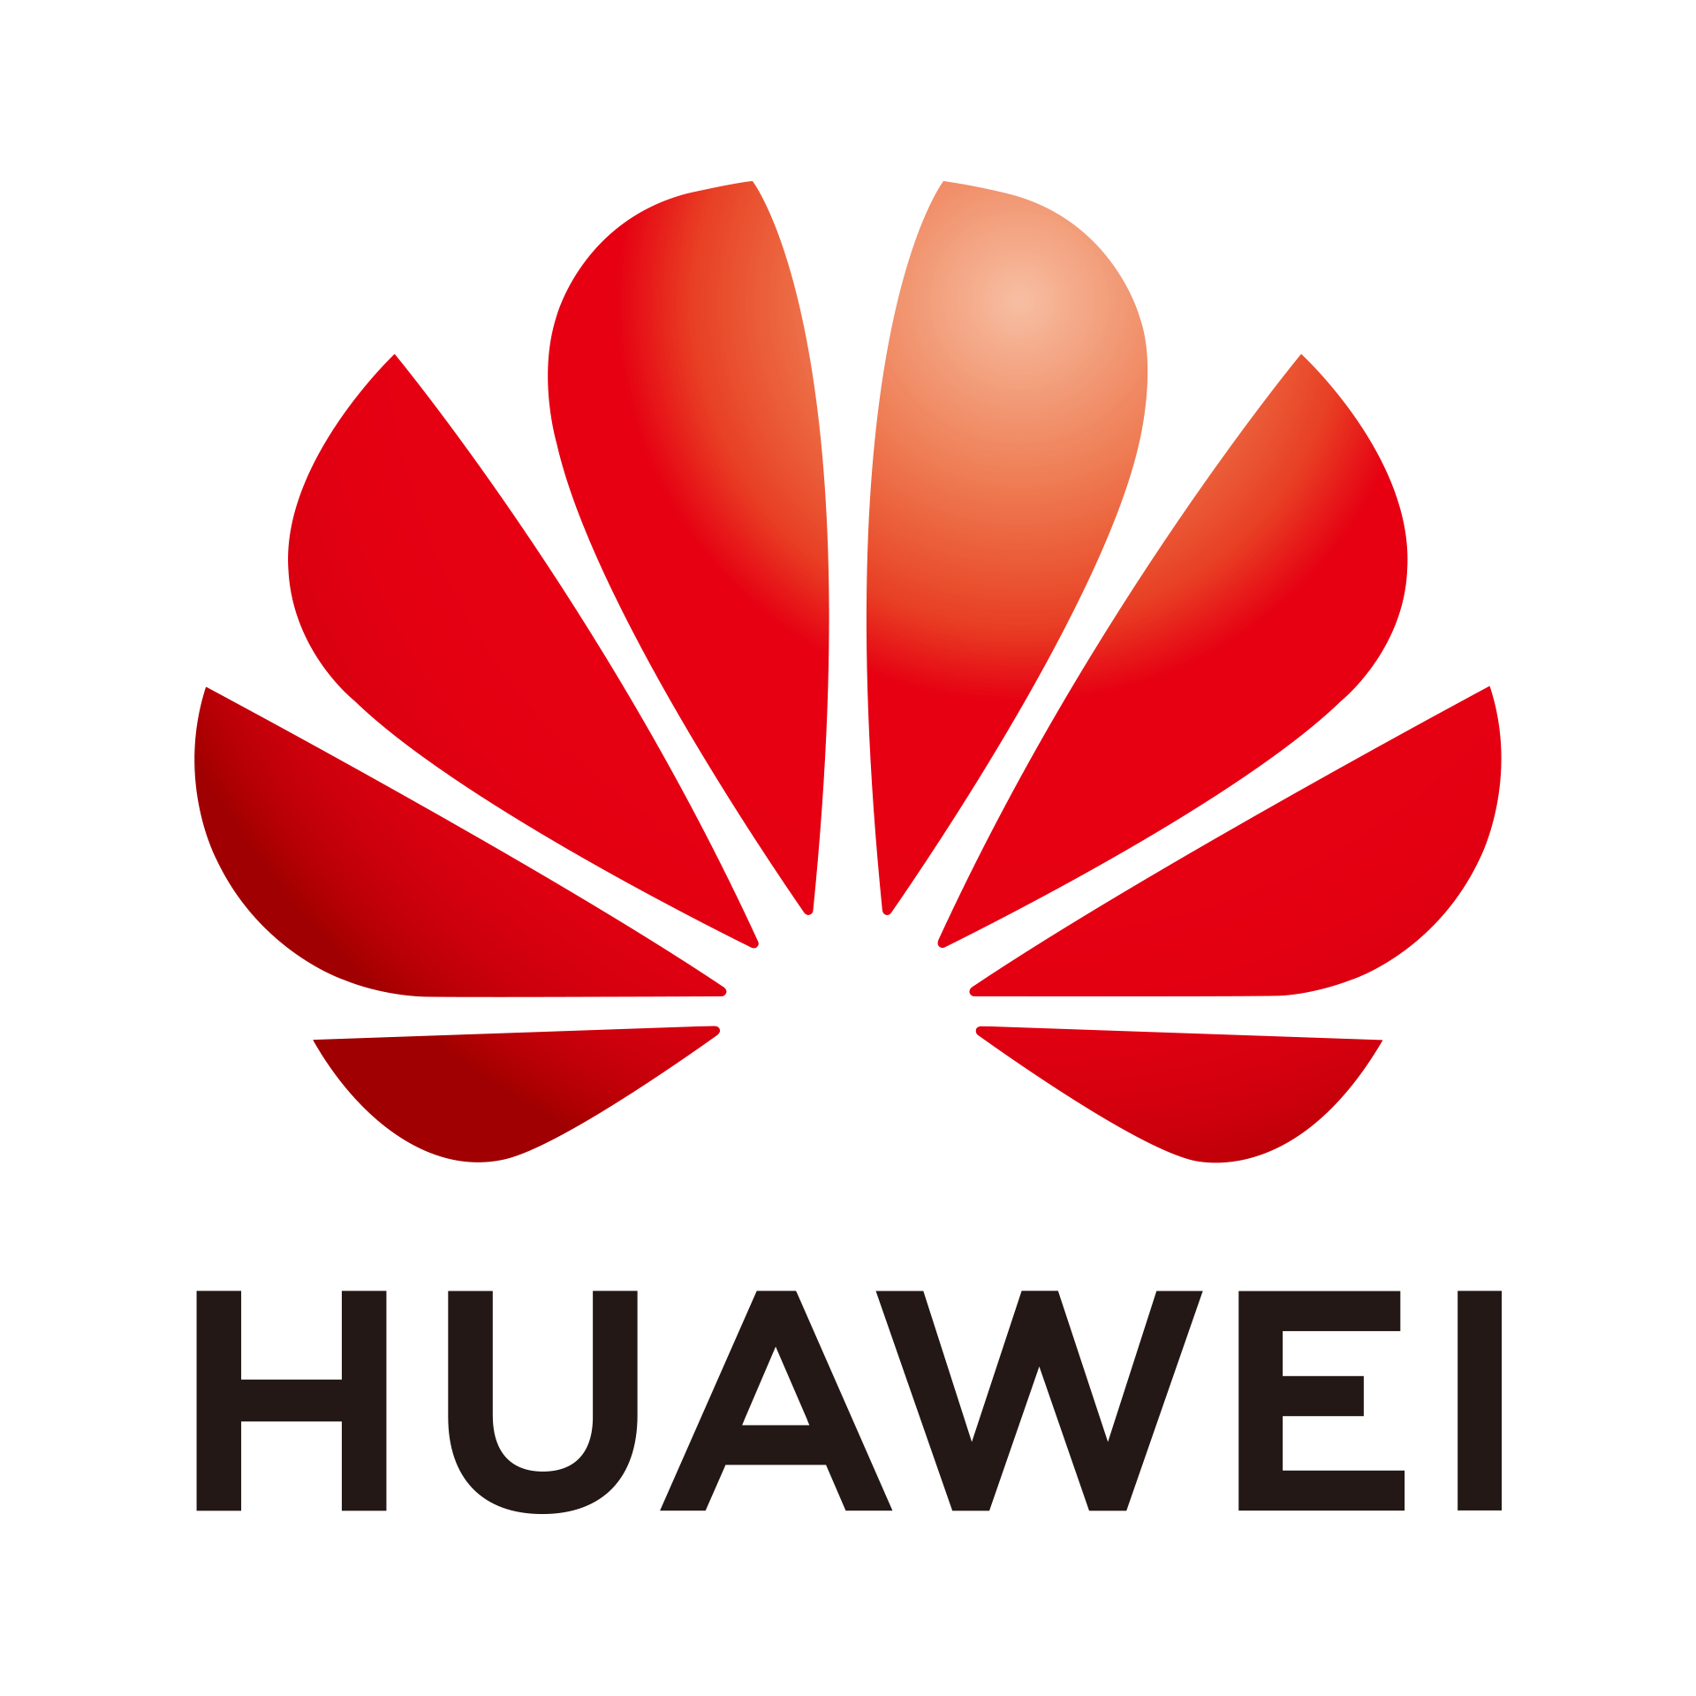






Our Advantages
Excellent quality management system guarantee the high quality
Strong R&D capacity can meet the special requirements of clients
For Enterprise Switches, working with the R&D team of New H3C Technologies Co., Ltd
For Industrial Switches, engineering design and manufacturing team over ten (10) years
Fast delivery: 3-5 working days after your confirmation.
Rich Experience for Big Partners and Big Projects
warranty:
3 years (Commercial)
5 years (Industrial)

Slide 8
THANKS FOR WATCHING
Starlink Technology
– The good feeling of security
You will benefit from this as well:
You will not only be supplying your customer with products,
You will also be giving them the good feeling of security!
sales@qixingtechnology.com
Danik Hu

